Slide 1
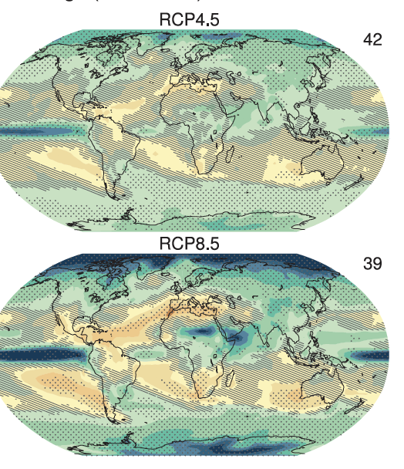
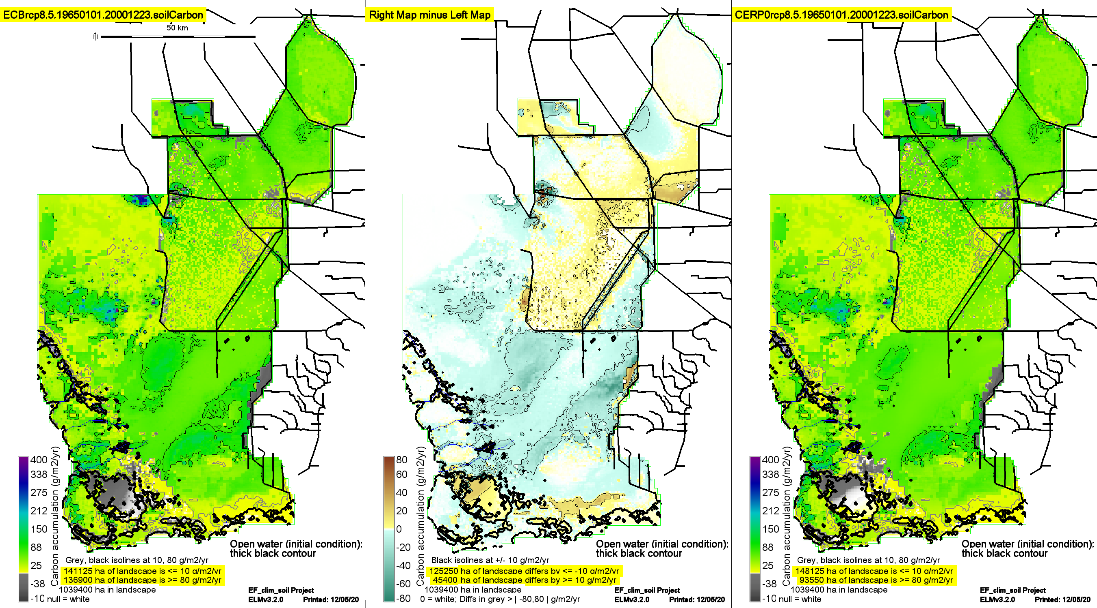
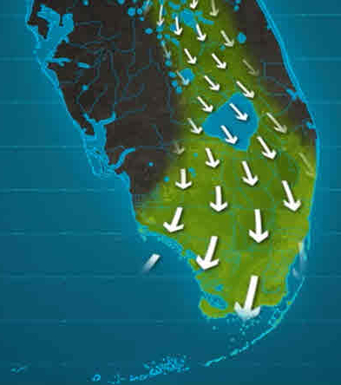
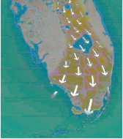
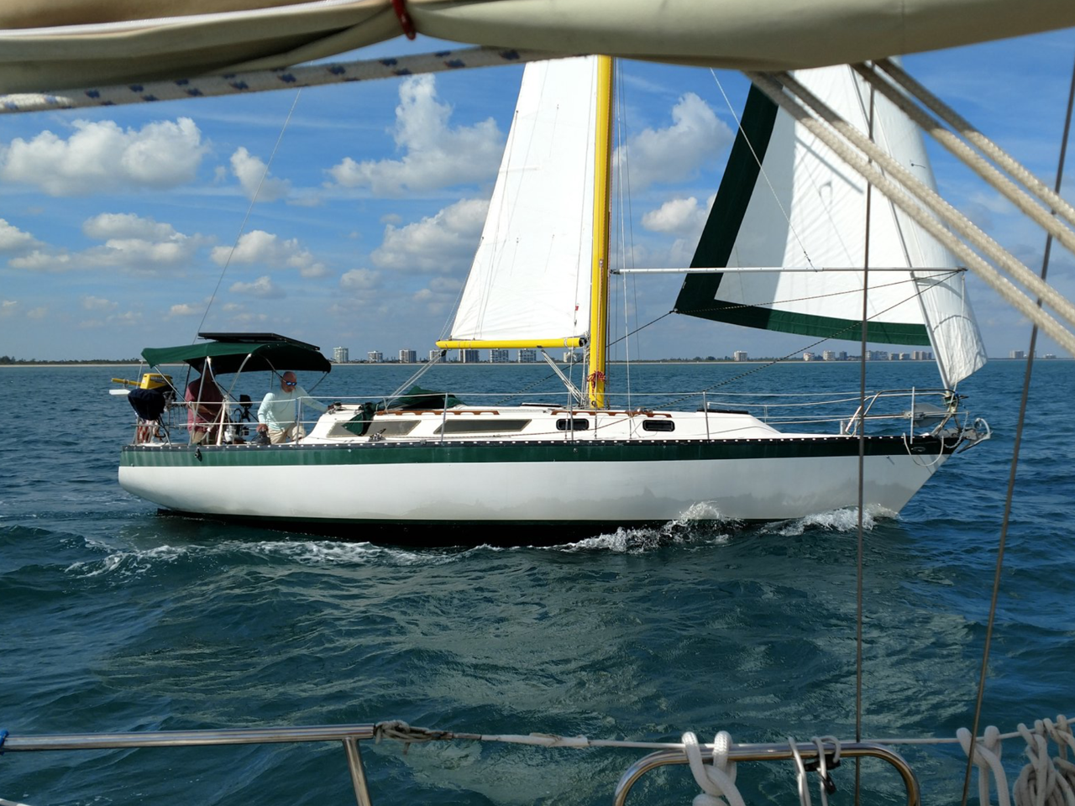
Landscape Soil Carbon Sequestration Under
Scenarios of Climate Change and CERP
climate scenarios
restoration scenarios
...
soil responses
GEER 2021
Carl Fitz^{1,3,4}
Rajendra Paudel²
Yogesh Khare²
Thomas Van Lent²
¹EcoLandMod, Inc.
²Everglades Foundation
³Univ. South Florida
⁴Florida International Univ.
Featuring...
Goldilocks’ View
of Soil Carbon
Flux Optima

Slide 2
Goldilocks soil accumulation rates
Soil carbon sequestration/accumulation rate is excellent, truly integrative quantification of wetland functionality
“Just right” (optimal rate)
Happy periphyton, macrophytes, soils (& thus consumers)
Definition of healthy freshwater wetland
10 – 80 gC m⁻² y⁻¹
“Too cold” (low rate)
Too high, or too low, water depths
reduced macrophyte production
increased soil loss under dry conditions
“Too hot” (high rate)
Too high nutrient loading
excessive macrophyte production & shading
replaced plant-animal species

Slide 3
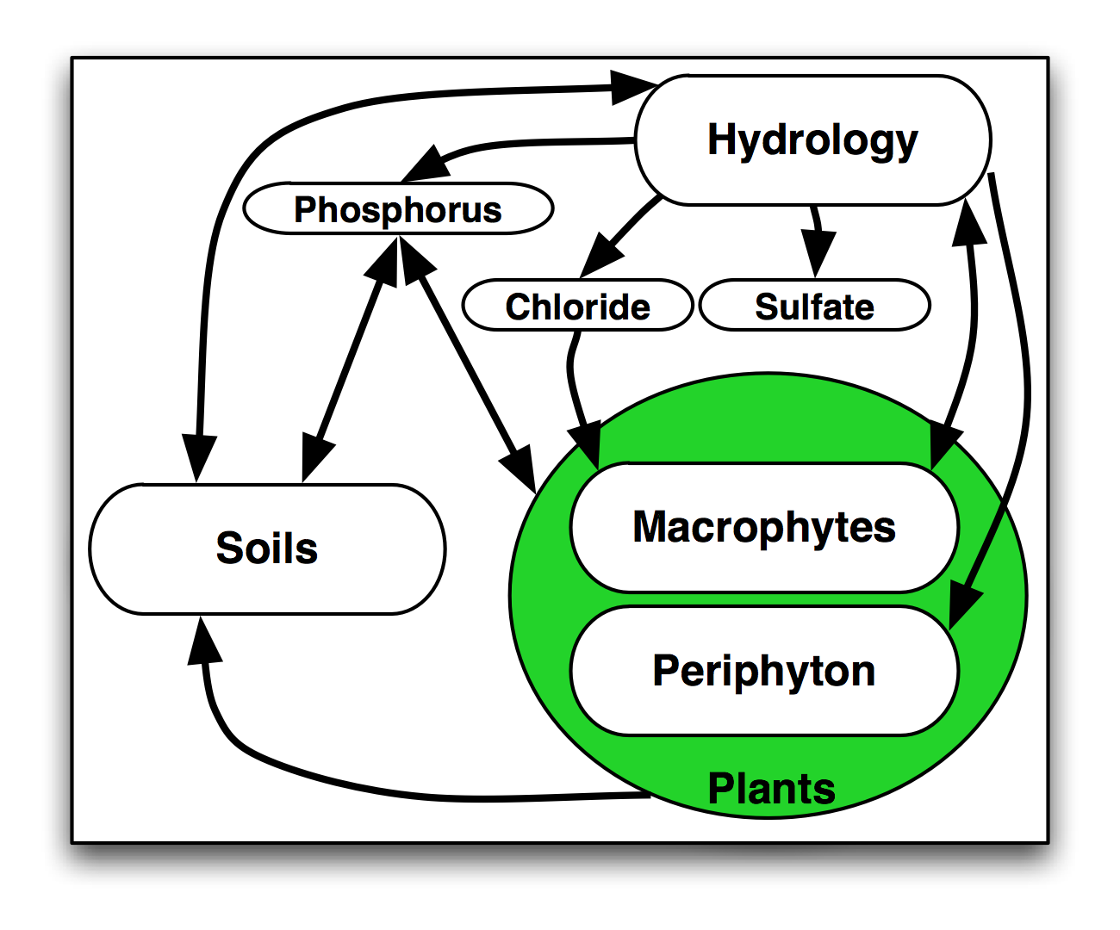
ELM Design: Integrating ecological interactions
Ecosystem model, integrating dynamic processes of hydrology, biogeochemistry, & plant biology
Arrows denote flows of carbon, water, & phosphorus, and information feedbacks among modules

Slide 4
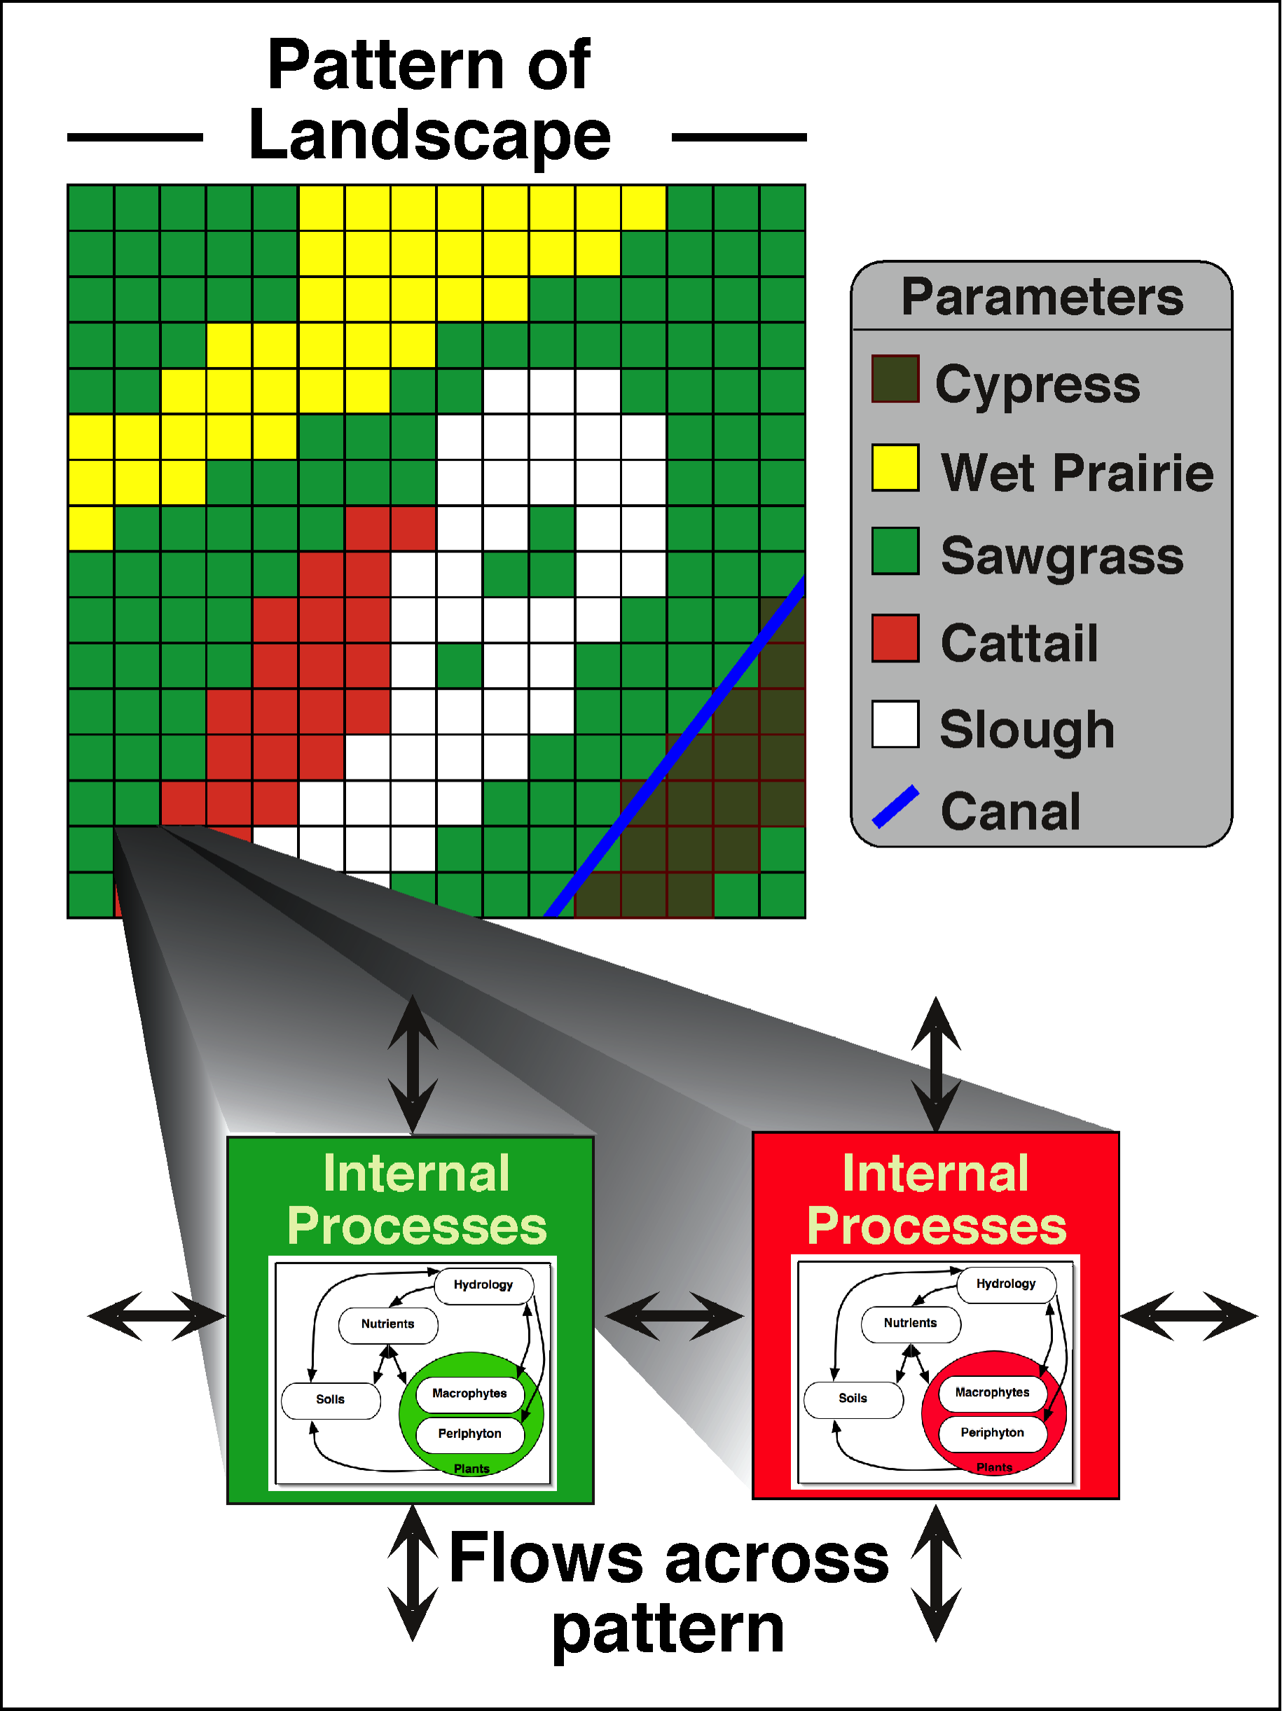
ELM Design: Pattern-process spatial interactions
Landscape pattern (of habitats) affects local ecosystem processes
Processes affect landscape pattern (via habitat succession)
Canals/rivers represented by exact vectors, with dynamic canal/river-marsh interactions; managed flows at point water control structures
Integrated surface-ground water exchanges

Slide 5
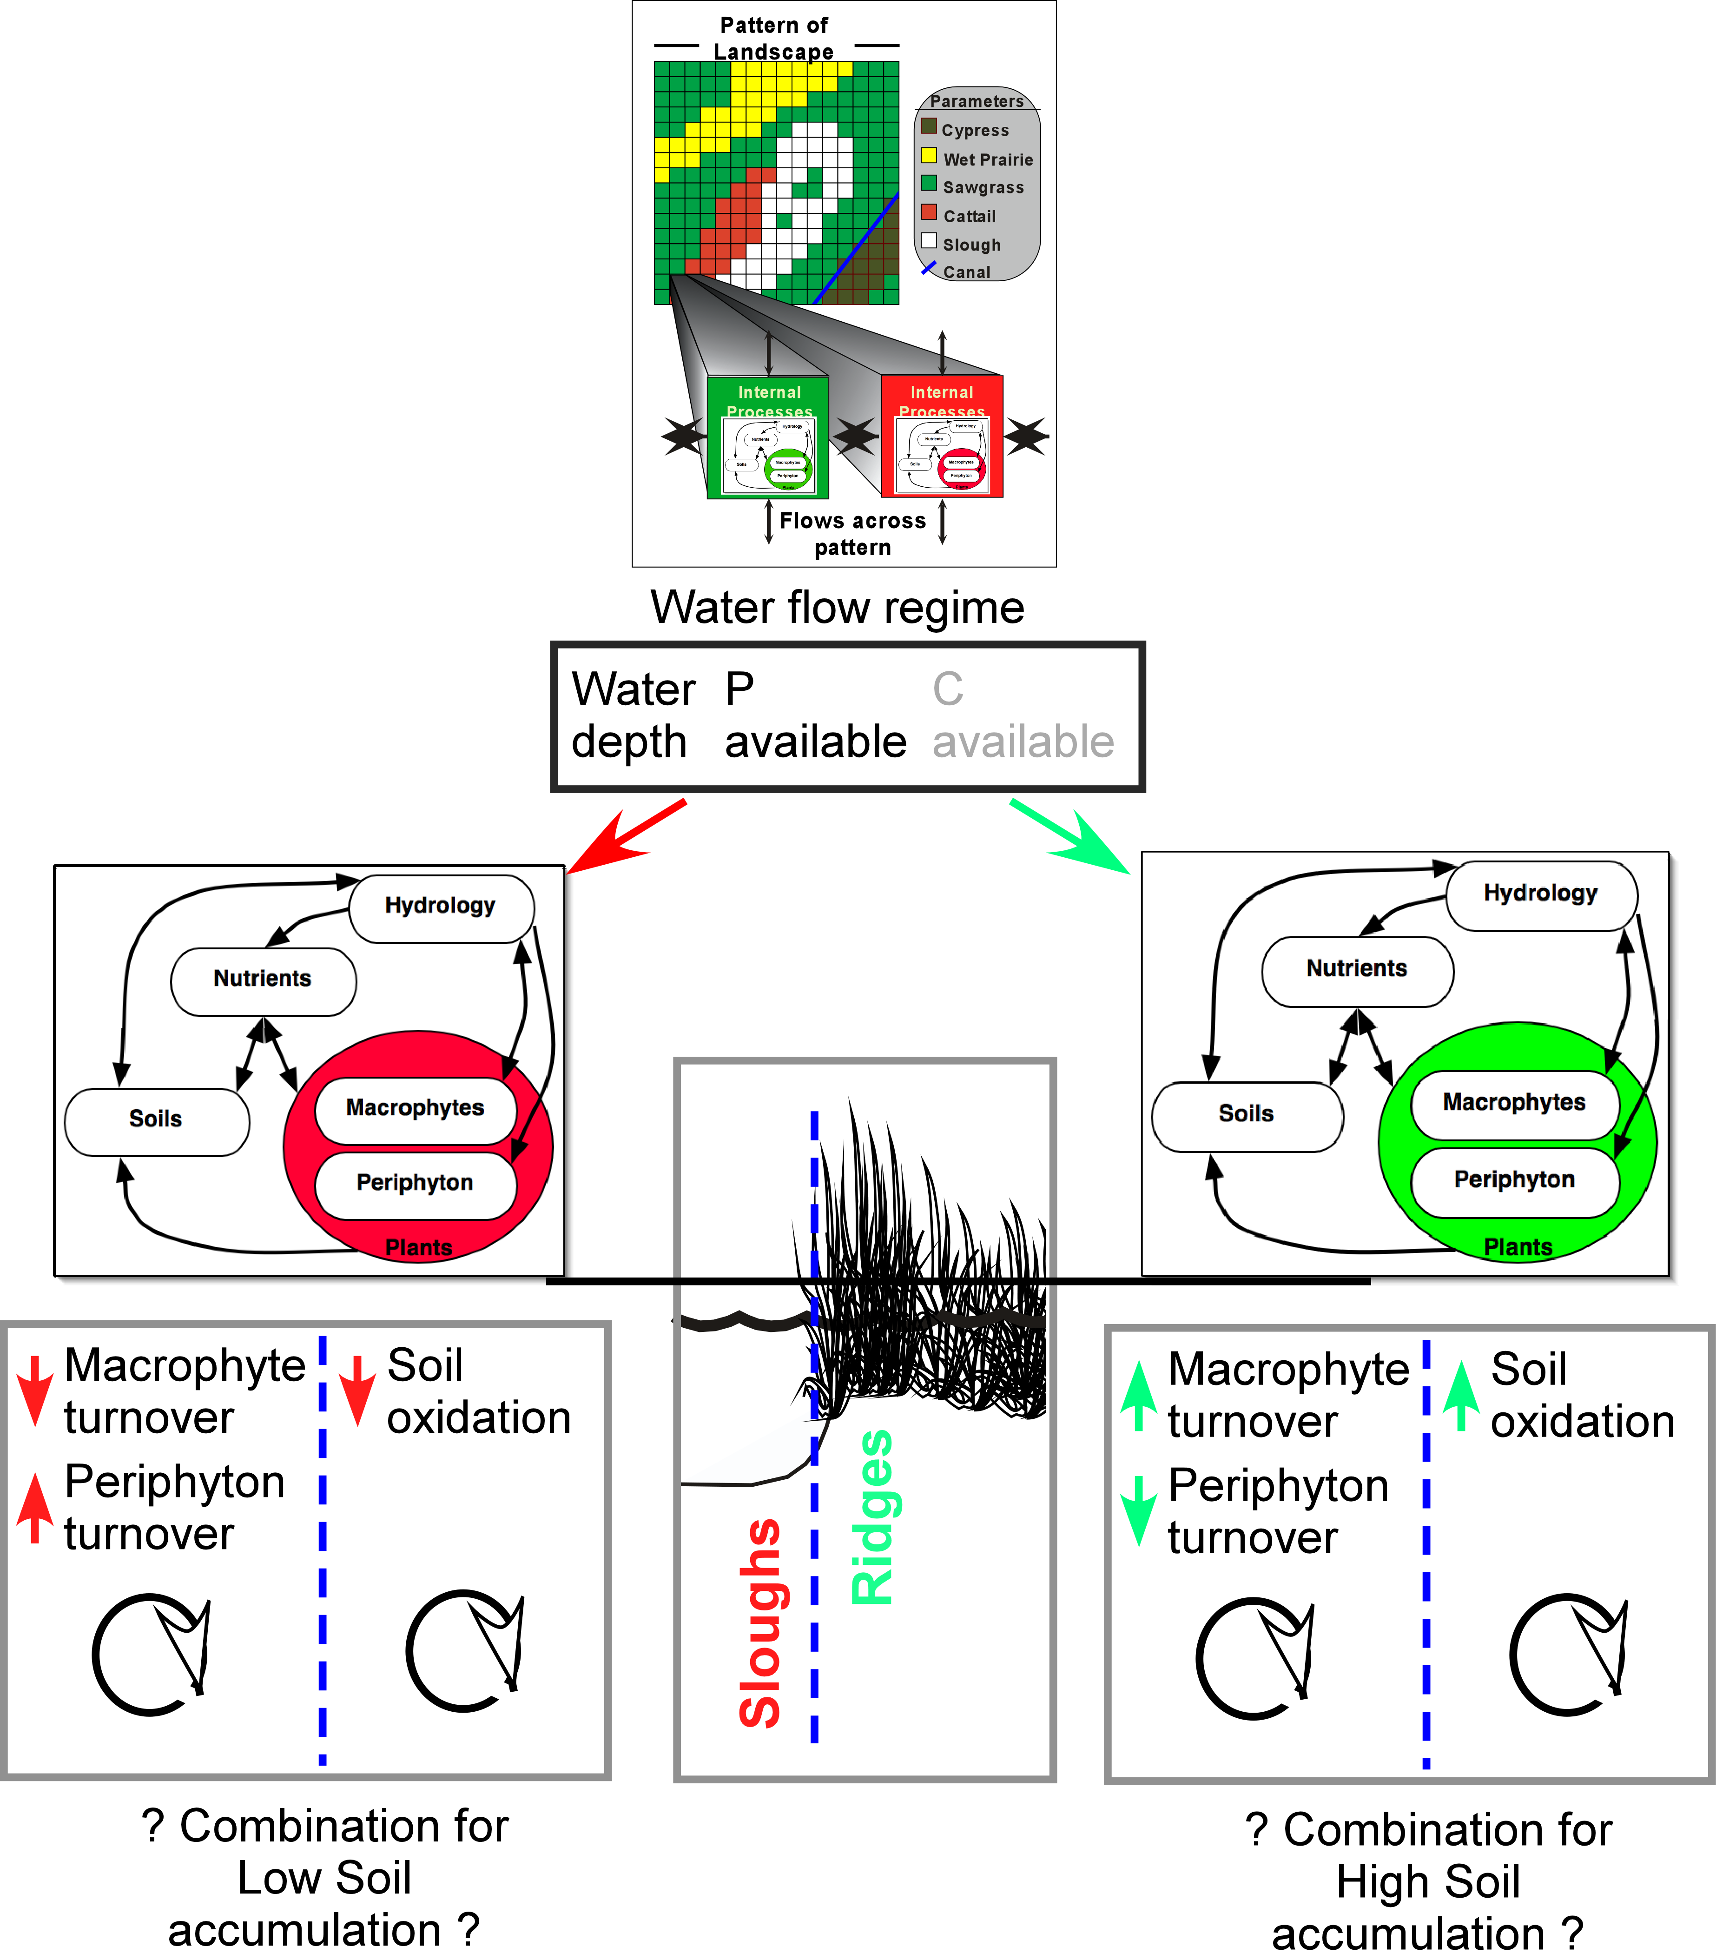
Past-results:
ELM captures these
ridge-slough soil accumulation
dynamics at century scales
Currently not considering
horizontal carbon transport &
sedimentation/resuspension
Slough habitat depths
Ridge habitat depths

Slide 6
ELM skill, refinement
Peer reviews over past 20+ years
Research journals: (Ecol Model; Restor Ecol; Crit Rev Env Sci Tec; Sust Water Qual Ecol; …)
CERP-application review panels: (Mitsch et al. Independent Panel; CERP Interagency Modeling Center Panel; USACE certification)
Updating-refining to new ELM v3.2 (...still a work in progress)
Extended Period-Of-Simulation (was thru 2000, now thru 2016)
Assimilating multiple new/refined data sources (esp. coastal glades)
Maps: Habitats, soils, coastal river/creek topology, …
FCE/other monitoring (e.g., salinity, TP, depth, …)
FCE/other research (e.g., soil processes, macrophytes, diatoms/periphyton, net ecosystem production, …)
Skill assessment updates - run ELM-standard stats
Have improved model skill in coastal/tidal regions, ongoing …

Slide 7
This application:
Compare landscape responses among 36-yr scenarios of future climate and future management combinations
3 Climate scenarios (drive SFWMM & ELM hydrology)
Hist is historical climate, a replication of 1965-2000 daily rain and pET
RCP4.5 is future climate, Representative Concentration Pathway 4.5, daily rain & pET from downscaled ensemble means of 27 GCMs
RCP8.5, similarly, is future climate, but higher global CO₂ concentrations
2 Water management scenarios (daily water control structure flows from SFWMM output, distributed via ELM fine-scale hydrology)
ECB is Existing Conditions Base, using current infrastructure and water management practices (applied to 36 yr future)
CERP0 is Comprehensive Everglades Restoration Plan, the full implementation of future infrastructure and water management
ELM hydro-ecological Performance Measures
Soil carbon accumulation rate over 36 year period
Other ELM metrics (flow/depth, TP, periphyton/diatoms, veg succession, etc) not presented here

Slide 8
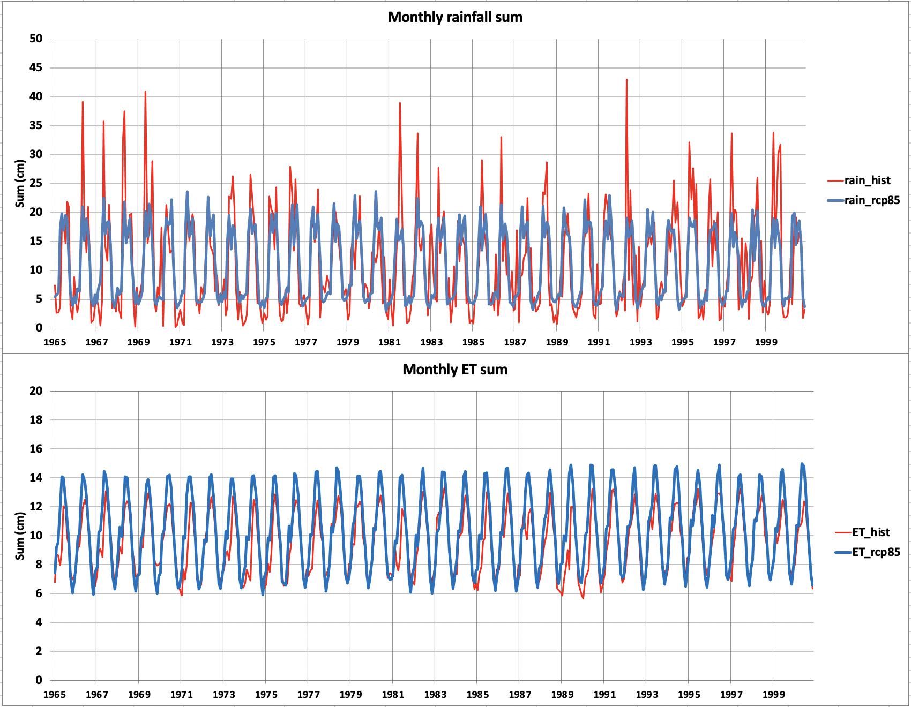
Future climate: downscaled ensemble means of
27 General Circulation Models (GCMs). See works of R. Paudel, J. Infanti
Rain – 36 yr:
RCP8.5 (&4.5) less variable than observed historical
ET – 36 yr:
RCP8.5 (&4.5) greater than observed historical

Slide 9
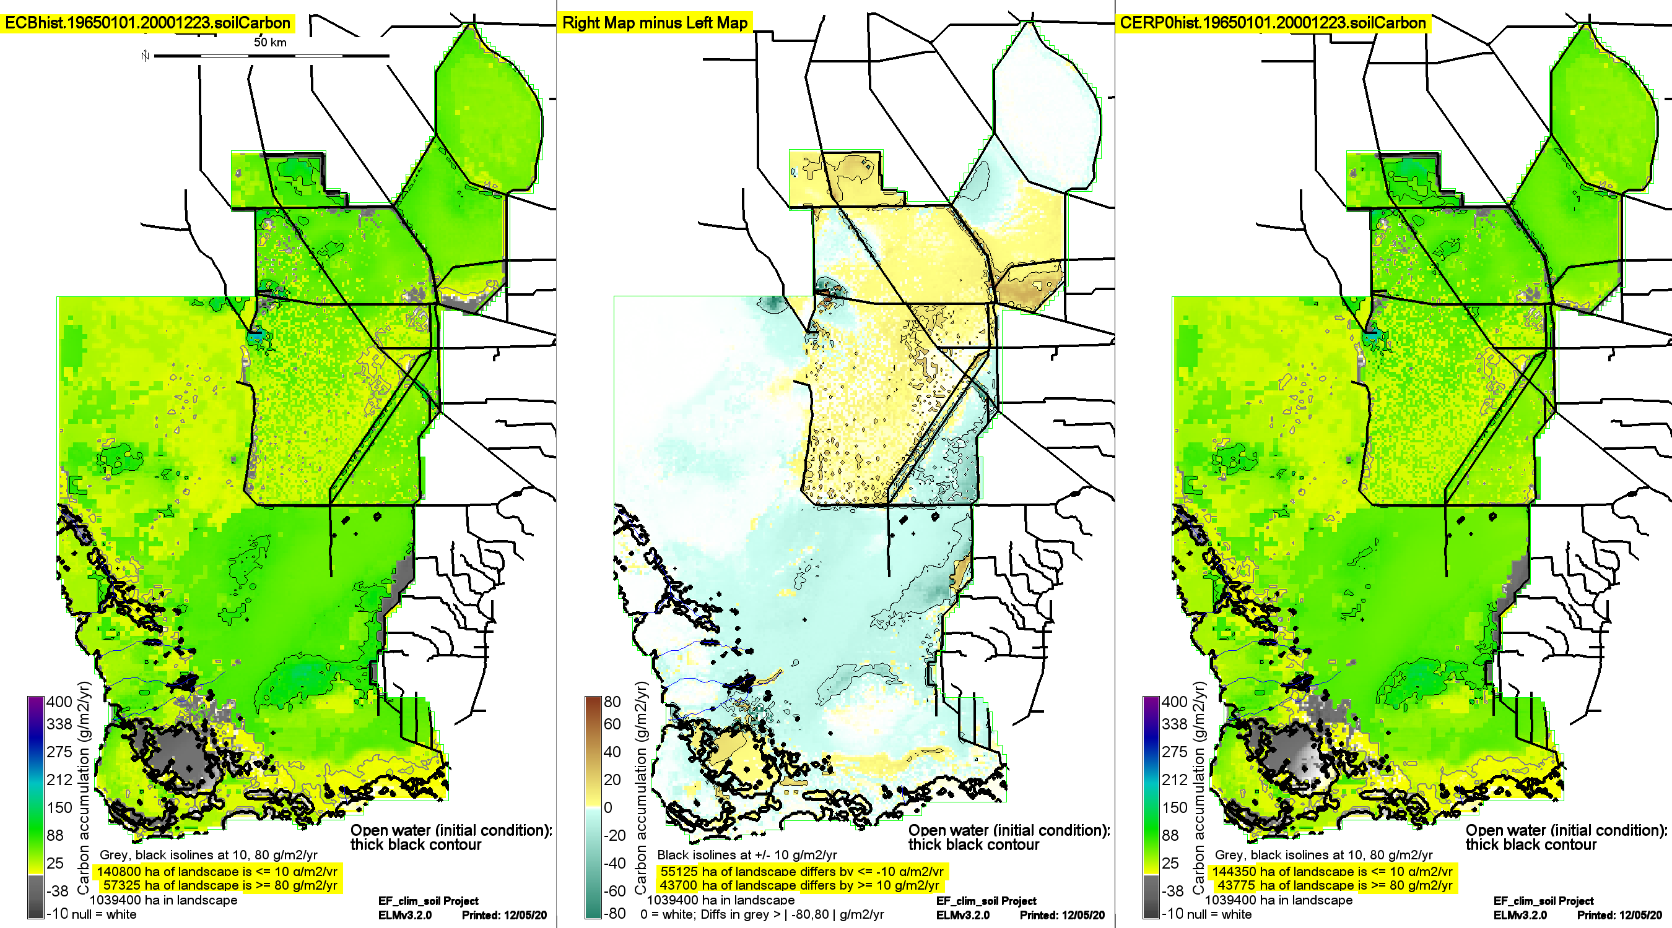
Soil carbon accumulation rates – 36 yr, 2016-2051
Major point:
Visualize general similarities in patterns
(showing all rates, not just Goldilocks)
Historical
Climate
RCP 4.5
Climate
Spatially, rates
differ subtly
among climate
scenarios
RCP 8.5
Climate
ECB
Difference
CERP
CERP tends to increase rates, varying spatially

Slide 10
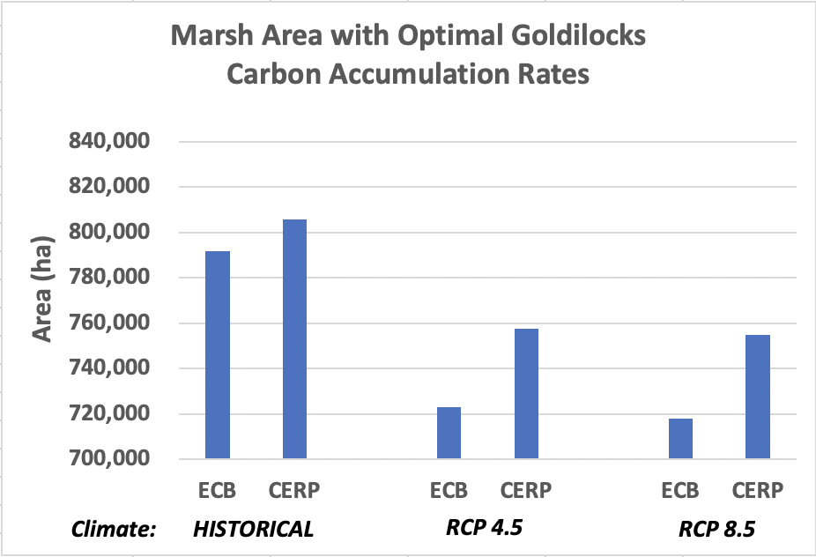
Regional landscape (~million* ha) responses,
scenarios of ECB vs CERP under 3 climates
*975,650 ha: WCAs, ENP, BCNP

Slide 11
Summary
Relative to baseline, CERP had integrated ecological benefits under historical climate (not much “news”, other than metric itself)
... AND CERP practices had (apparently even higher relative) benefits under future climate (vs. historical) scenarios
Integrated ecological dynamics may respond to significant reduction in interannual rainfall variability
Plans include discrimination of different GCMs to resolve more of the natural rainfall variability
... AND to impose associated future Sea Level Rise water and salinity levels in the coastal Everglades

Slide 12
ELM updating…
Assimilating multiple monitoring & experimental results from Florida Coastal Everglades LTER program
Extrapolating local-scale research across heterogeneous landscapes & multiple decades (i.e., spatio-temporal integration)

