Slide 1
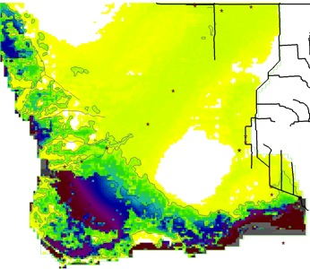
Tortoise or Hare? Landscape Hydro-Ecological Interactions
From Presses (Sea Level Rise) and Pulses (Freshwater flows)
In the Coastal Everglades
GEER 2019
Carl Fitz^{1,2,3}
Mark Rains²
Hilary Flower^{2,4}
Evelyn Gaiser³
¹EcoLandMod, Inc.
²Univ. South Florida
³Florida International Univ.
⁴Eckerd College
Some of the FCE &
related models

Slide 2
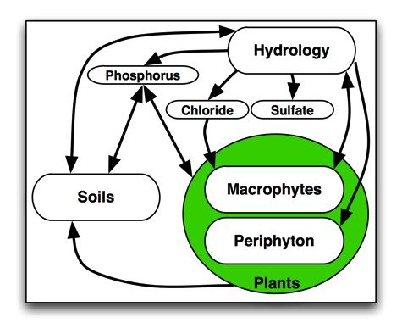
ELM Design: Integrating ecological interactions
Ecosystem model, integrating dynamic processes of hydrology, biogeochemistry, & plant biology
Arrows denote flows of carbon, water, & phosphorus, and information feedbacks among modules

Slide 3
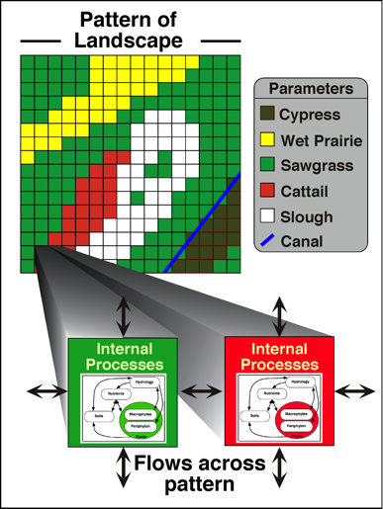
ELM Design: Pattern-process spatial interactions
Landscape pattern (of habitats) affects local ecosystem processes
Processes affect landscape pattern (via habitat succession)
Canals/rivers represented by exact vectors, dynamic canal/river-marsh interactions; managed flows at point water control structures
Integrated surface-ground water exchanges

Slide 4
ELM skill, refinement
Peer reviews over past 20+ years
Research journals: (Ecol Model; Restor Ecol; Crit Rev Env Sci Tec; Sust Water Qual Ecol; …)
CERP-application review panels: (Mitsch et al. Independent Panel; CERP Interagency Modeling Center Panel; USACE certification)
Updating-refining to new ELM v3.0 (work in progress)
Extending Period-Of-Simulation (was thru 2000, now 2005, soon 2015)
Assimilating multiple new/refined data sources (esp. coastal glades)
Maps: Habitats, soils, coastal river/creek topology, …
FCE/other monitoring (e.g., salinity, TP, depth, …)
FCE/other research (e.g., soil processes, macrophytes/diatoms/periphyton, net ecosystem production, …)
Skill assessment updates - run ELM-standard stats
Have improved model skill in coastal/tidal regions, ongoing …
1-year target for most improvements for formal update(s)

Slide 5
This application:
Compare landscape responses among 36-yr scenarios of restoration flows and Sea Level Rise (SLR) combos
Scenario games bookends
CERP0_std is Scenario Base, restoration flows standard
CERP0_SLR: Annual SLR = 2 cm/yr applied to CERP0 coastal boundary; no management change/response
CERP0_SLR_2xflow: Annual SLR = 2 cm/yr applied to CERP0 coastal boundary; ~2x CERP0 structure flows to southern glades
Simulating water management & ecology
SFWMM managed flows (CERP0 from Everglades Foundation)
ELM driven by SFWMM (point) water control structures, then simulates finer scale hydrology and ecological dynamics
Hydro-ecological Performance Measures
Water depths & flow velocities
Floc P & surface water chloride concentrations
Soil processes
Succession among habitats (& diatom communities; see Mazzei)

Slide 6
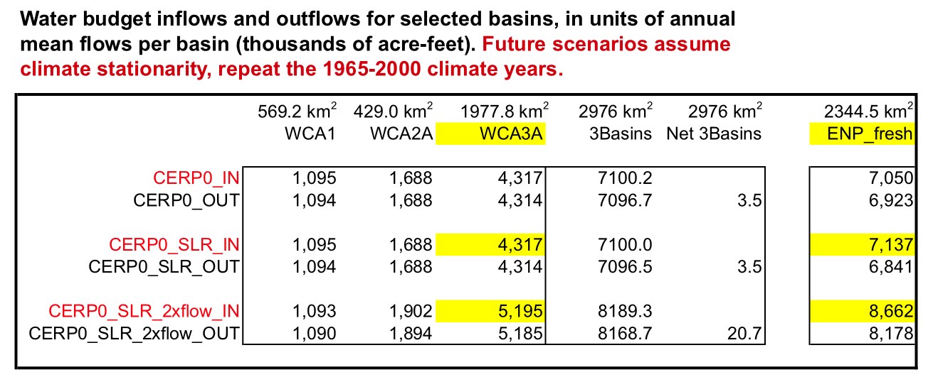
Water budgets
Showing total (rain, gwater, seepage, overland, structure) inflows into freshwater component of ENP increased by ~1.2X under CERP0_SLR_2xflow vs. CERP0_SLR

Slide 7
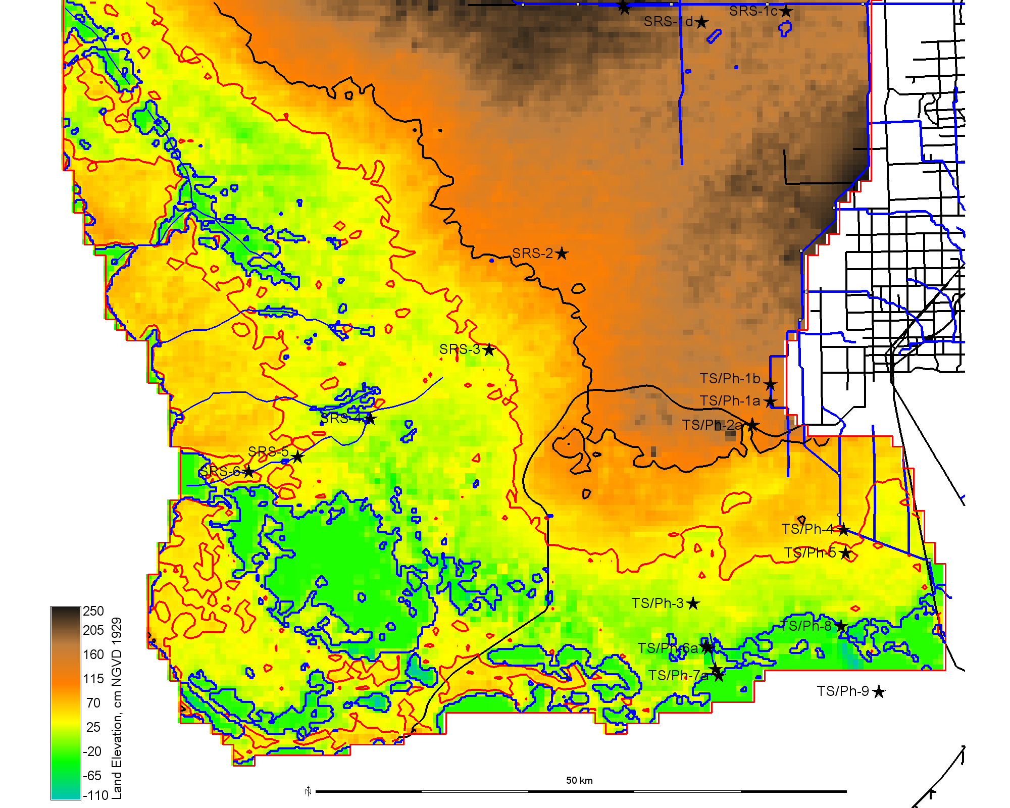
Everglades National Park (model subdomain)
1
FCE
SR Slough
transect
2
Miami
3
1
4
2
5
Gulf of Mexico
6
FCE
T Slough
transect
3
6
7
Florida
Bay

Slide 8
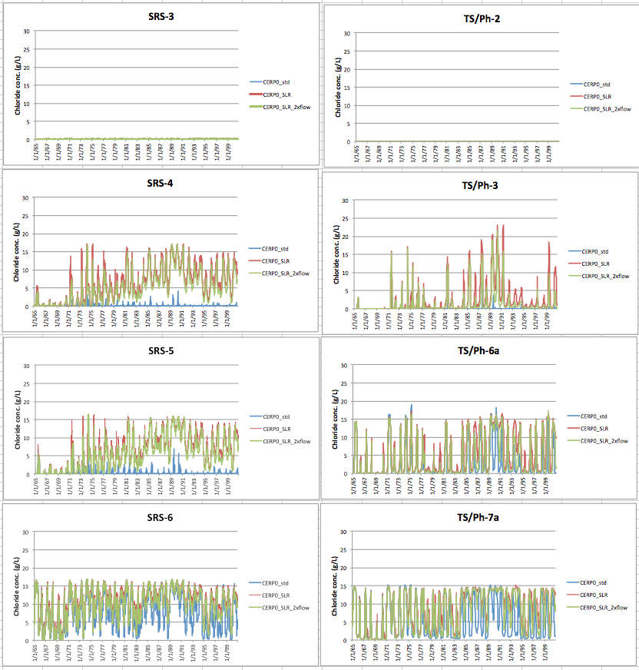
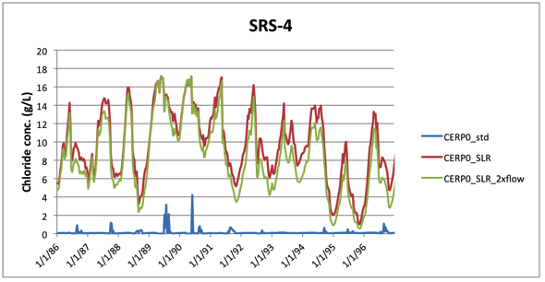
Surface water chloride, 36yr: CERP0_std; CERP0_SLR; CERP0_SLR_2xflow
Freshwater
Flows
Coastal
Tidal

Slide 9
Surface water chloride – end of wet season, last year of sim
CERP0
Diff: right - left
CERP0_SLR
CERP0
Diff: right - left
CERP0_SLR_2xflow

Slide 10
Floc P concentration – end of wet season, last year of sim
CERP0
Diff: right - left
CERP0_SLR
CERP0
Diff: right - left
CERP0_SLR_2xflow

Slide 11
P accumulation – Period of Simulation
CERP0
Diff: right - left
CERP0_SLR
CERP0
Diff: right - left
CERP0_SLR_2xflow

Slide 12
Peat accretion – Period of Simulation
CERP0
Diff: right - left
CERP0_SLR
CERP0
Diff: right - left
CERP0_SLR_2xflow

Slide 13
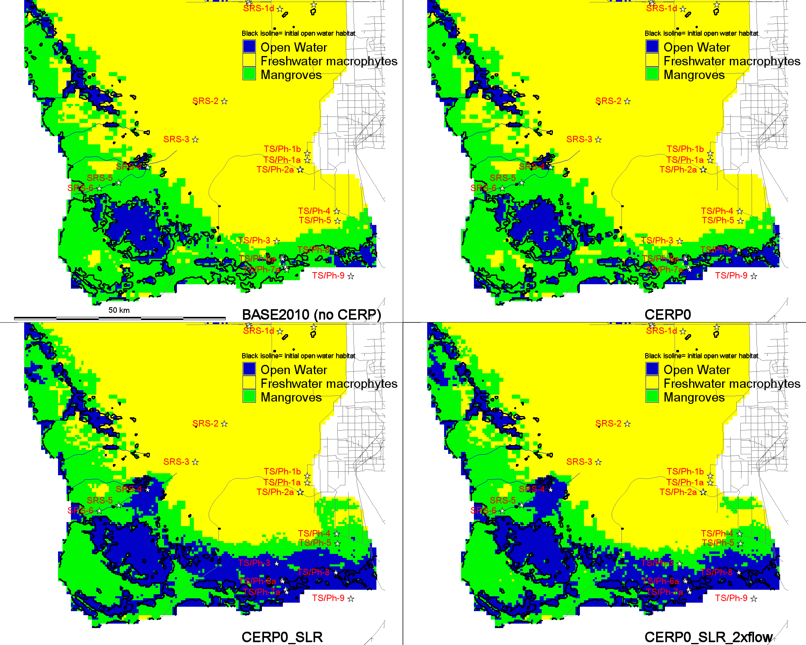
Habitat succession, end of wet season, last year of sim
reference
line
reference
line
reference
line
reference
line

Slide 14
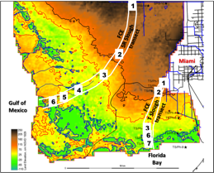
Summary-ELM scenario games
Incremental SLR (~60cm/36yr) led to gradual ecosystem changes
With standard CERP exposed to this SLR, coastal ecotone patterns of salinity, P, soil processes, and mangroves & open-water habitats moved inland
Additional (CERP+) flows slightly counteracted this movement, depending on spatial location, flow paths
The tortoise of SLR probably “wins”, but the hare’s additional pulses of freshwater flows pushes back to a meaningful extent

Slide 15
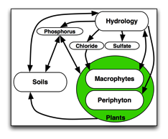
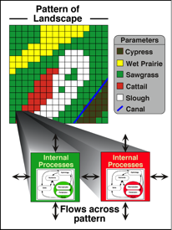
ELM updating…
Assimilating multiple monitoring & experimental results from FCE LTER program
ELM: Extrapolate local-scale research understanding across heterogeneous landscapes & multiple decades (aka spatio-temporal integration)
Iterative process, leading to improved models, and to refined hypotheses

