Slide 1
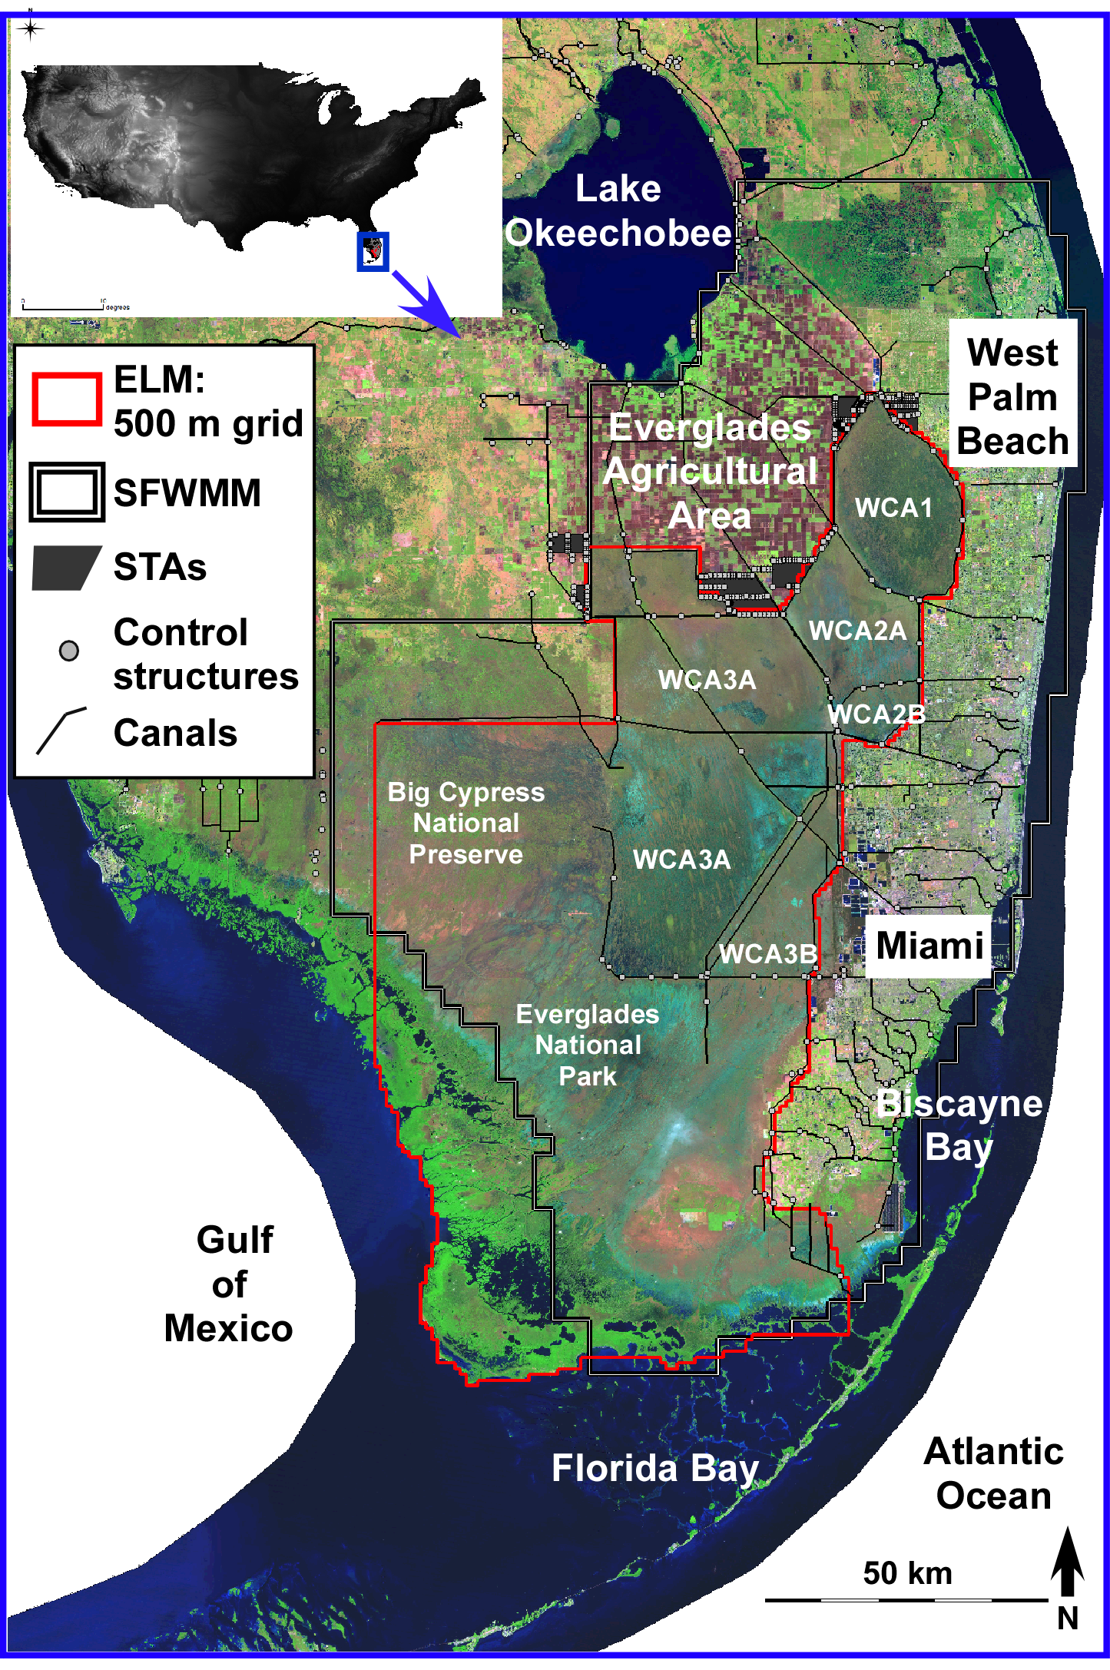
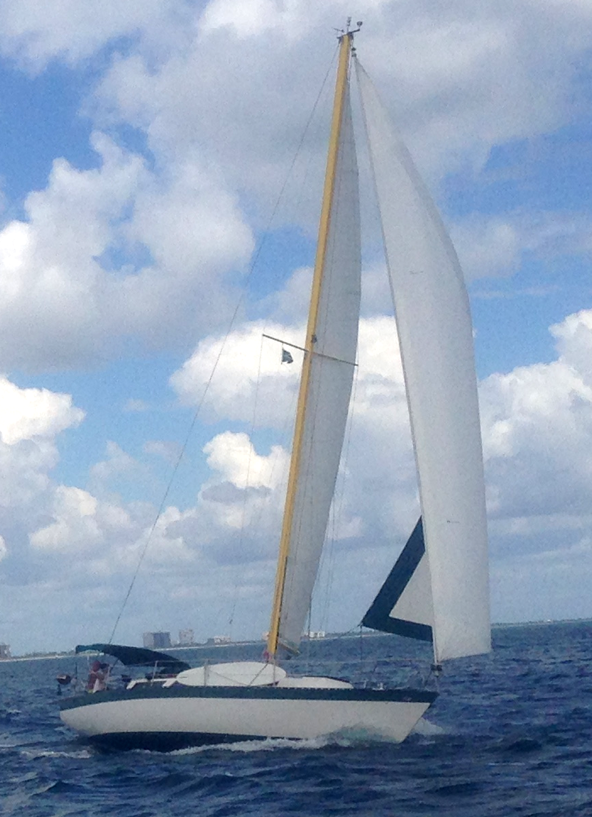
Integrated Landscape Trends of Hydrology, Nutrients,
Soils, and Vegetation Under Future Management Scenarios
GEER 2017
H. Carl Fitz^{1,2}
Hilary D. Flower²
Mark C. Rains²
¹EcoLandMod, Inc.
²Univ. South Florida
Some of the FCE &
related models

Slide 2
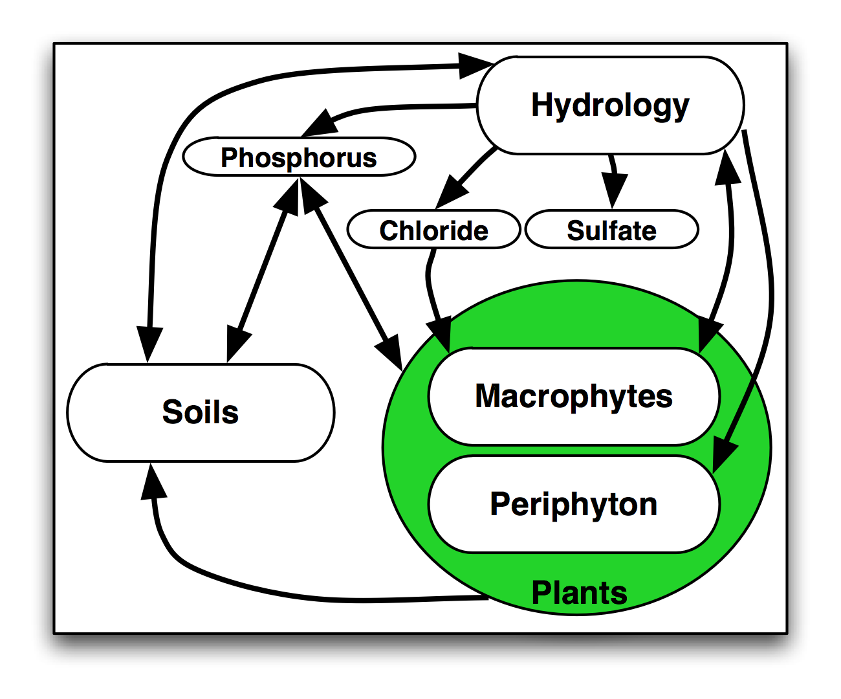
ELM Design: Integrating ecological interactions
Ecosystem model, integrating dynamic processes of hydrology, biogeochemistry, & plant biology
Arrows denote flows of carbon, water, & phosphorus, and information feedbacks among modules

Slide 3
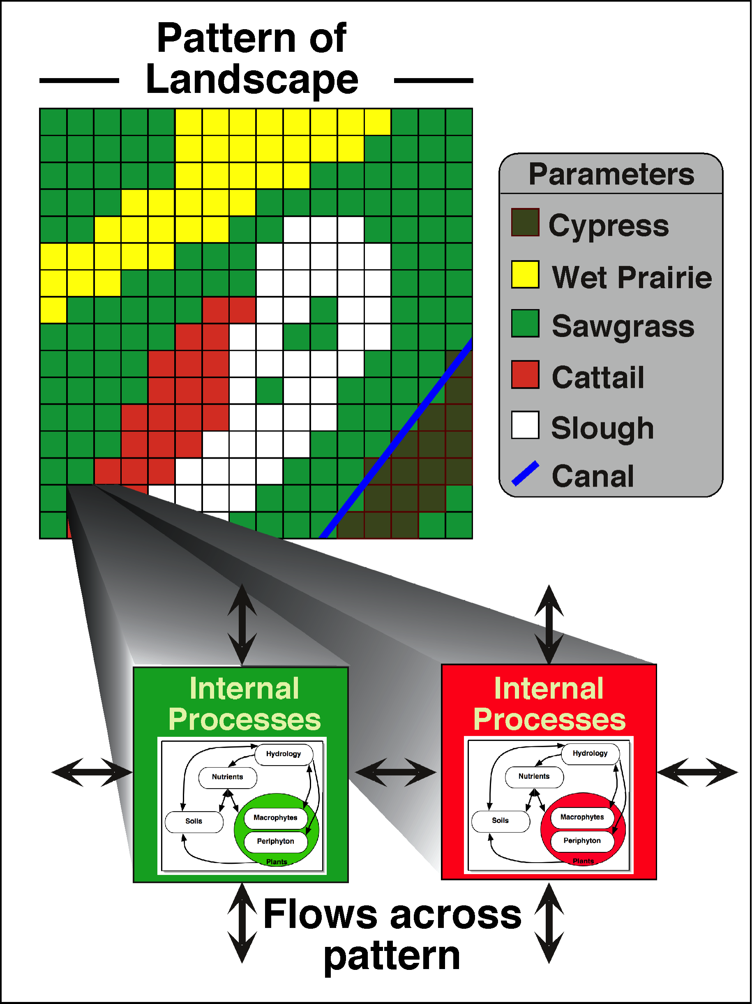
ELM Design: Pattern-process spatial interactions
Landscape pattern (of habitats) affects local ecosystem processes
Processes affect landscape pattern (via habitat succession)
Canals represented by exact vectors, dynamic canal-marsh interactions; managed flows at point water control structures
Integrated surface-ground water exchanges

Slide 4
ELM skill assessments
Calibration/validation (decadal history-matching) statistics
Marsh stage (median, 82 stations): bias= 0 cm; NS Efficiency= 0.61
Water quality bias (median, 78 stations):
Phosphorus: marsh= 0 mg•L⁻¹; canals= 0 mg•L⁻¹
Chloride: marsh= 8 mg•L⁻¹; canals= 13 mg•L⁻¹
Sulfate: marsh= 0 mg•L⁻¹; canals= -2 mg•L⁻¹
Other ecological metrics
Range of analyses at multiple scales/regions (soil processes, succession of cattail, sawgrass, mangroves …)
Peer reviews over past 20+ years
Research journals (Ecol Model; Restor Ecol; Crit Rev Env Sci Tec; Sust Water Qual Ecol; …)
Applications for CERP (Independent Panel; Interagency Modeling Center)

Slide 5
ELM applications:
Scenarios - water quality & periphyton
GEER 2017 session,
Evelyn Gaiser, Melodie Naja, Daniel Childers, and Carl Fitz
Scenarios - soils
GEER 2015 session,
Todd Osborne, Carl Fitz, and Steve Davis
Restoration Ecology (2017)
doi: 10.1111/rec.12496
Scenarios - sulfate & methylmercury distributions
GEER 2017 session,
William Orem, David Krabbenhoft, George Aiken, and Carl Fitz
Related CERP ASR project w/ others: Sust Water Qual Ecol (2014)
doi:10.1016/j.swaqe.2014.11.004

Slide 6
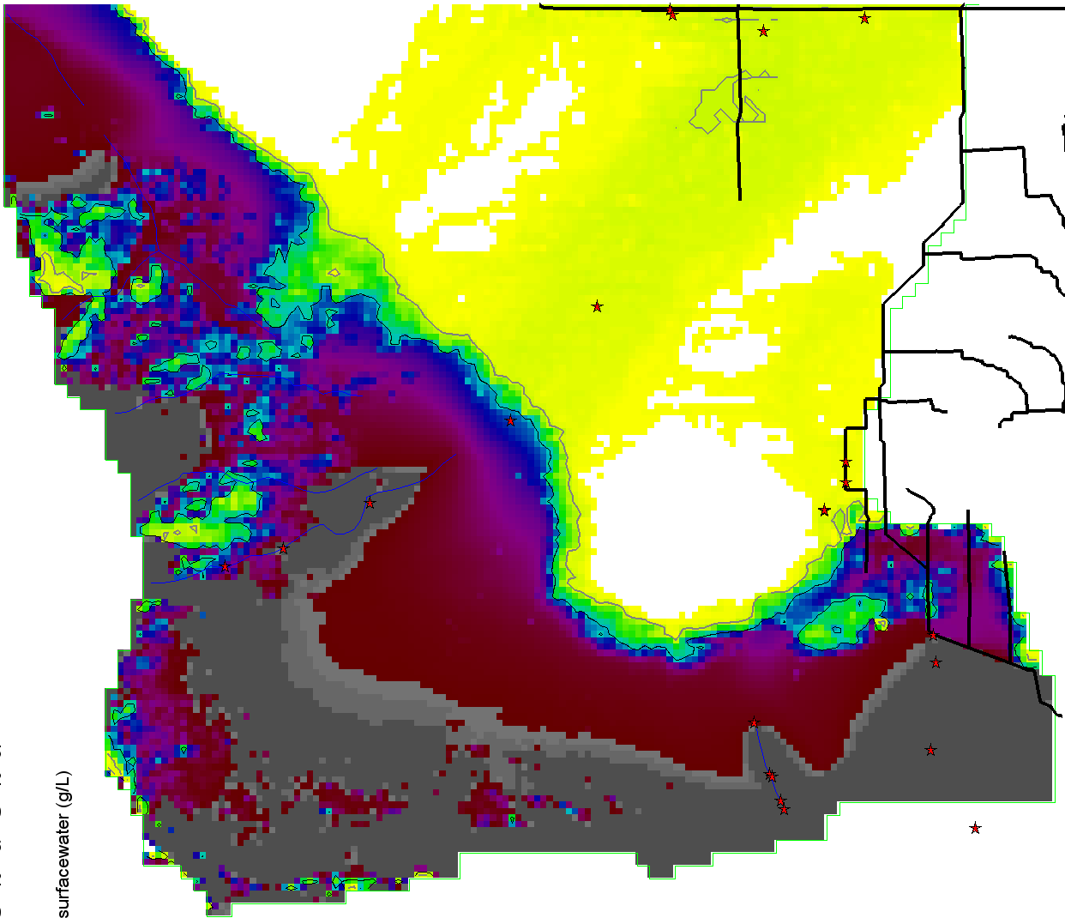
ELM application:
Visioning the future: scenarios modeling of the Florida Coastal Everglades (FCE)
Press/pulse from
freshwater flows
Just submitted to Environmental Management;
Hilary Flower, Mark Rains, and Carl Fitz;
SFWMM runs provided by Jayantha Obeysekera and Jenifer Barnes (SFWMD)
Press from
Sea Level Rise
Chloride incursions, 50cm SLRise

Slide 7
ELM application overview
Compare landscape responses among 36-yr scenarios of climate change and Sea Level Rise (SLR)
Climate-SLR bookends
Existing condition Base
Increase rain 10%; Increase temp 1.5°C & pET 7%; Increase Initial sea level by 50cm
Decrease rain 10%; Increase temp 1.5°C & pET 7%; Increase Initial sea level by 50cm
Water management & ecology
SFWMM water management (Obeysekera & Barnes, SFWMD)
ELM driven by SFWMM (point) water control structures, then simulated finer scale hydrology and ecological dynamics
Hydro-ecological Performance Measures
Water depths & flow velocities
Phosphorus & chloride concentrations (sulfate ignored here)
Soil processes
Succession among habitats

Slide 8
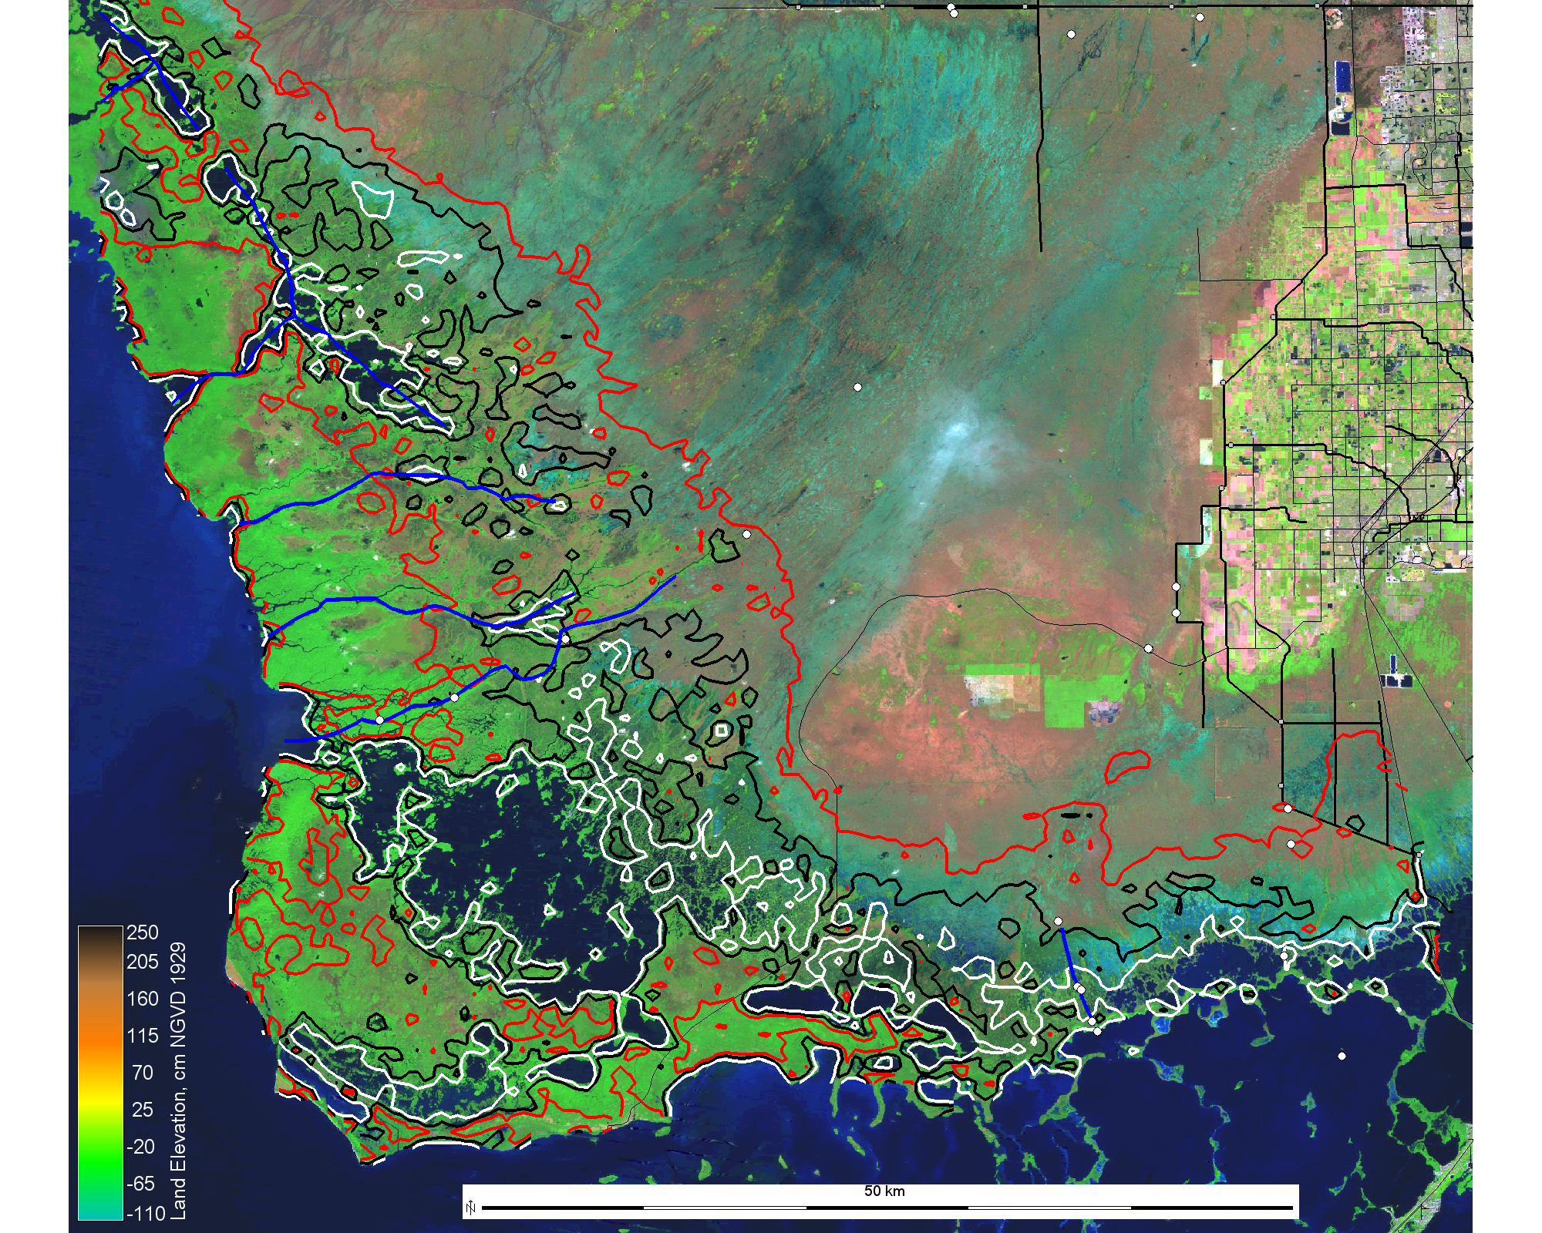
Everglades National Park (model subdomain)
1
FCE sites for the two transects
1
1
1
Main Park Road
Shark River Slough
Creek/River
Canals
Lostman Creek
Topographic Contours
2
0.40 m
0.20 m
0.0 m
Broad River
Harney River
3
1
4
Shark River
Long Pine Key
2
Gulf of Mexico
5
6
6
Taylor Slough
3
6
N
6
7
7
Florida Bay
25 km

Slide 9
Surface water depth
Baseline
N
130
20 km
95
Surface water depth
Relative to land surface (cm)
SRS 3
60
0.40 m
Topographic contour
30
15
100 mg/L isochlor
0
Null
-RF
+RF
SRS 3
SRS 3

Slide 10
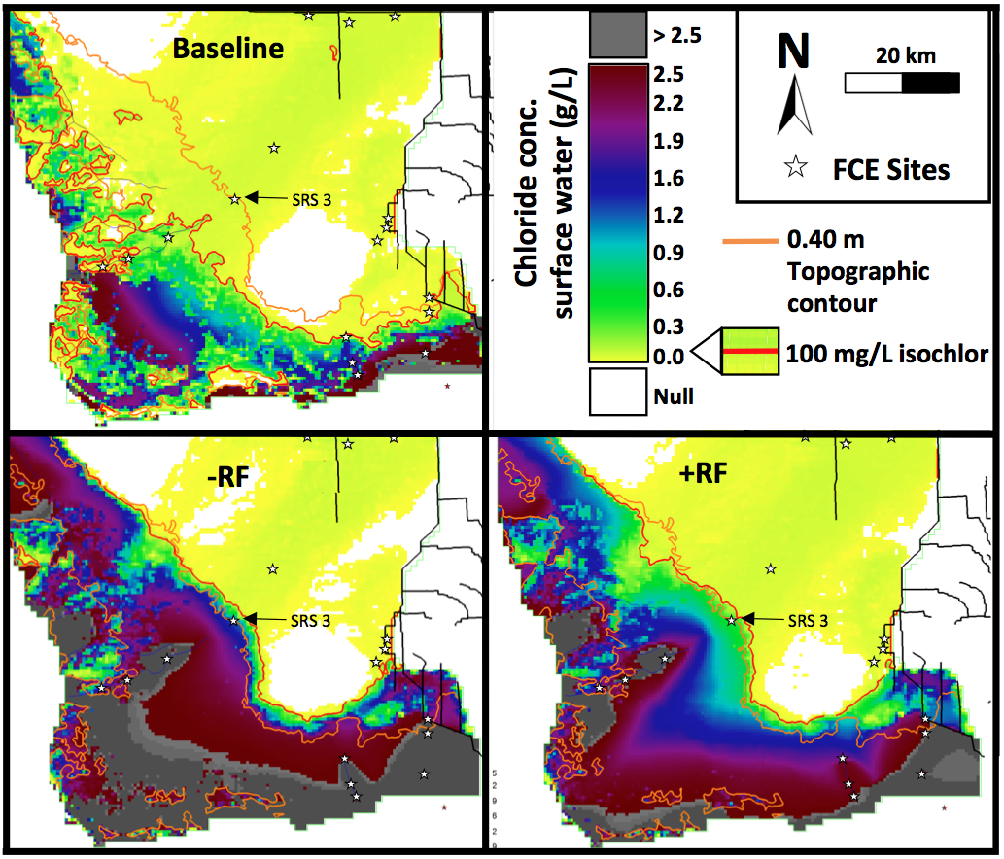
Surface water chloride

Slide 11
FCE SRS transect gradients: Water depth & chloride
Baseline
SRS 4
-RF
SRS 3
+RF
Surface water depth relative to land surface (m)
0
-
SRS 4
Chloride concentration
of surface water (g/L)
SRS 3
Distance from upstream, km
1
2
3
4
5
6
FCE monitoring sites for Shark River Slough transect

Slide 12
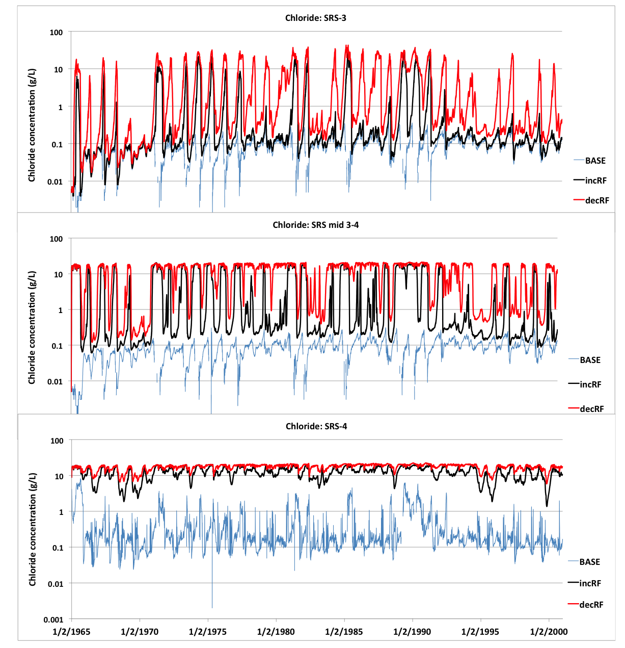
Spatio-temporal gradients: chloride

Slide 13
Baseline
N
20
20 km
17
14
11
Peat accumulation
(mm/yr)
SRS 3
8
4
0.40 m
Topographic contour
1
-2
-5
100 mg/L isochlor
Peat
accretion
Null
-RF
+RF
SRS 3
SRS 3
-RF minus Baseline
2.0
+RF minus Baseline
1.5
Peat
accretion
differences
faster
1.0
0.5
SRS 3
0.0
SRS 3
-0.5
slower
-1.0
-1.5
-2.0

Slide 14
Phosphorus accumulation
Phosphorus accumulation
Difference from Baseline (mg/m²/yr)
-RF minus Baseline
+RF minus Baseline
25
19
more
12
6
0
SRS 3
-6
SRS 3
less
-12
-19
-25
> 25 < -25
Beyond range
of scale

Slide 15
Habitat succession
Baseline
N
Freshwater Habitat
20 km
Mangrove boundaries:
Solid gray curve = -RF scenario
Dashed gray curve = +RF scenario
Mangrove Forest
SRS 3
Open Water
0.40 m
Topographic contour
100 mg/L isochlor
-RF
+RF
SRS-3
SRS-4
TS/Ph-2
TS/Ph-6
SRS-3
SRS-4
TS/Ph-2
TS/Ph-6

Slide 16
Habitat succession synthesis
Less rain
More rain
-RF
Initial
+RF
283,000 ha
Freshwater Habitats
196,000 ha
210,000 ha
182,500 ha
117,000 ha
138,000 ha
Mangroves
54,000 ha
Open water
79,000 ha
111,000 ha

Slide 17
Integration…
Modeling & data-research integration advancing within FCE LTER program
ELM: Ecosystem process integration works (but difficult: e.g., “funky” model vegetation can cascade to dynamics of soils, nutrients, …)
ELM: Extrapolate local-scale research understanding across heterogeneous landscapes & multiple decades (aka spatio-temporal integration)
FCE: Multi-model integration, with linking/learning among models of various scales and processes
Iterative process, leading to improved models*, and to refined hypotheses
* All models are wrong, but some are useful.

Slide 18
…. End of meeting – sail away!

